Slide 1

Something Fishy
Helsinki’s Fisherman’s Friend
Team Alpha

Slide 2
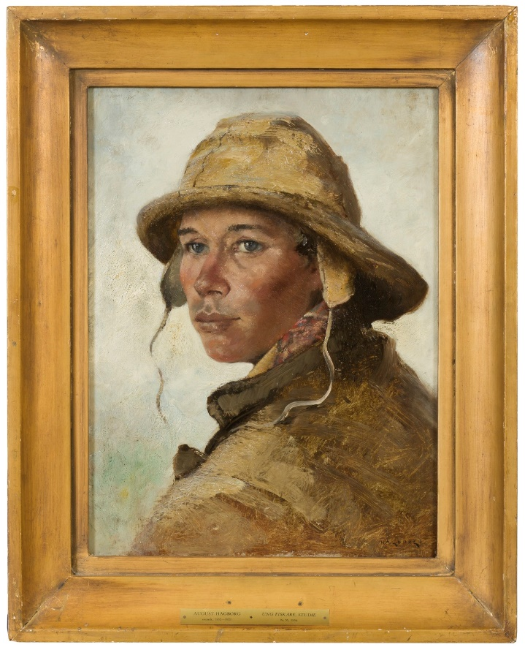
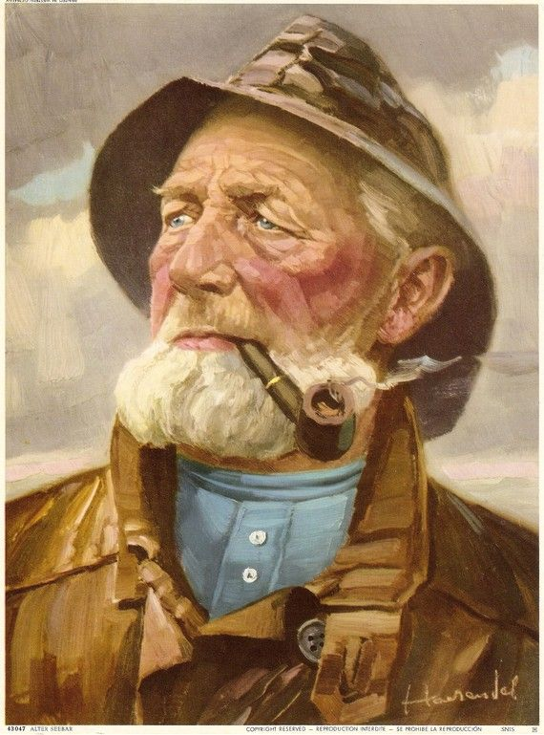
Initial aim
Final goal
We want to create an app for the ’uninformed’ fisherman who has issues in identifying a suitable spot to fish.
Issue 1: unfamiliarity with fishing spots in Hki
Issue 2: Different areas have different fish stock and conditions require different fishing techniques.
Log book for avid fishermen who want more
Hook: Lure & hook user for prospective session by showing weather conditions
Line: Record your catches, connect to the DB
Sinker: Save it to the DB & retrieve it for summary info, catch history.
Increment of potentially working app
1. User stories

Slide 3
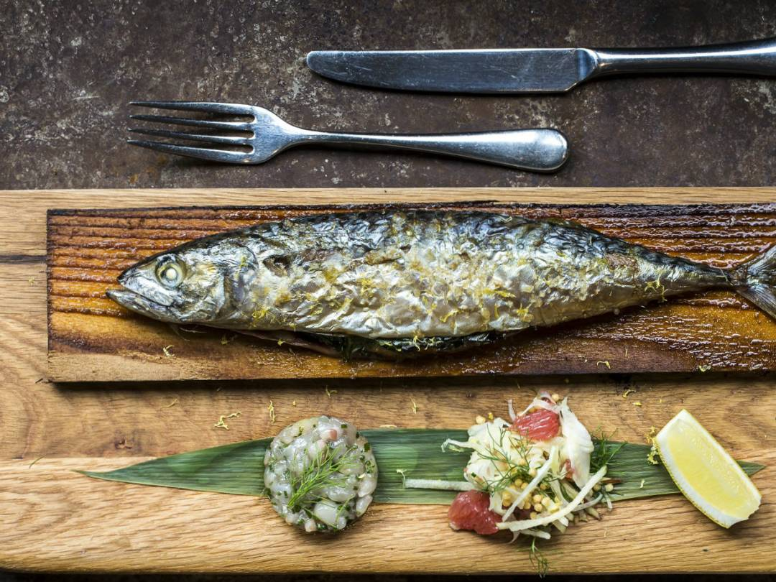
Implementation
Project Aims & Objectives
People
Follow Up
Material
Methods
Relevance & Need
Impact
Learning
2. Project

Slide 4
Implementation
Project Aims & Objectives
People
Follow Up
Material
Methods
Relevance & Need
Impact
Learning
2. Project

Slide 5
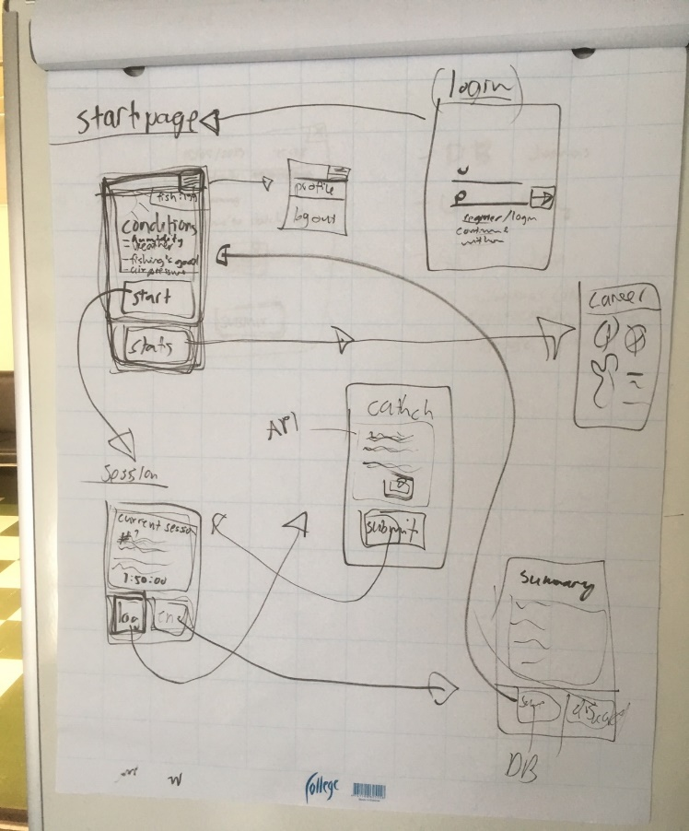
Coordination & distribution tools
Trello (People) and Git & GoogleDocs (Material)
APIs
Weather & Mapping
Communication tools
Slack & Whatsapp
Sketching & mock-up tools
Proto.io/Mock-ups
Paper, lots of paper
Sticky notes
Working tools
VS Studio Code, MongoDB, Image Manipulation SW
-
-
3. Tools

Slide 6
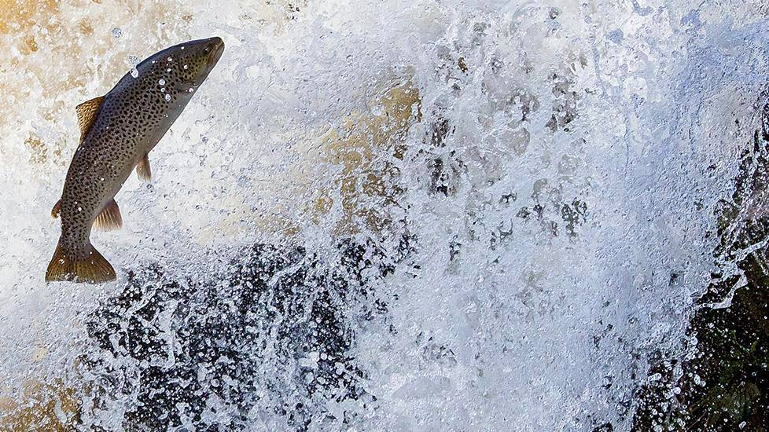
“Remember, a dead fish can float downstream, but it takes a live one to swim upstream”
“
Commitment,
Focus,
Openness,
Respect,
Courage
Trello Board Alpha
4. People

Slide 7
Next steps
Catch analytics´
Creation of community features (Sharing)
Add own position to map
5. Future

Slide 8
Thank you!
Demo time

Slide 9
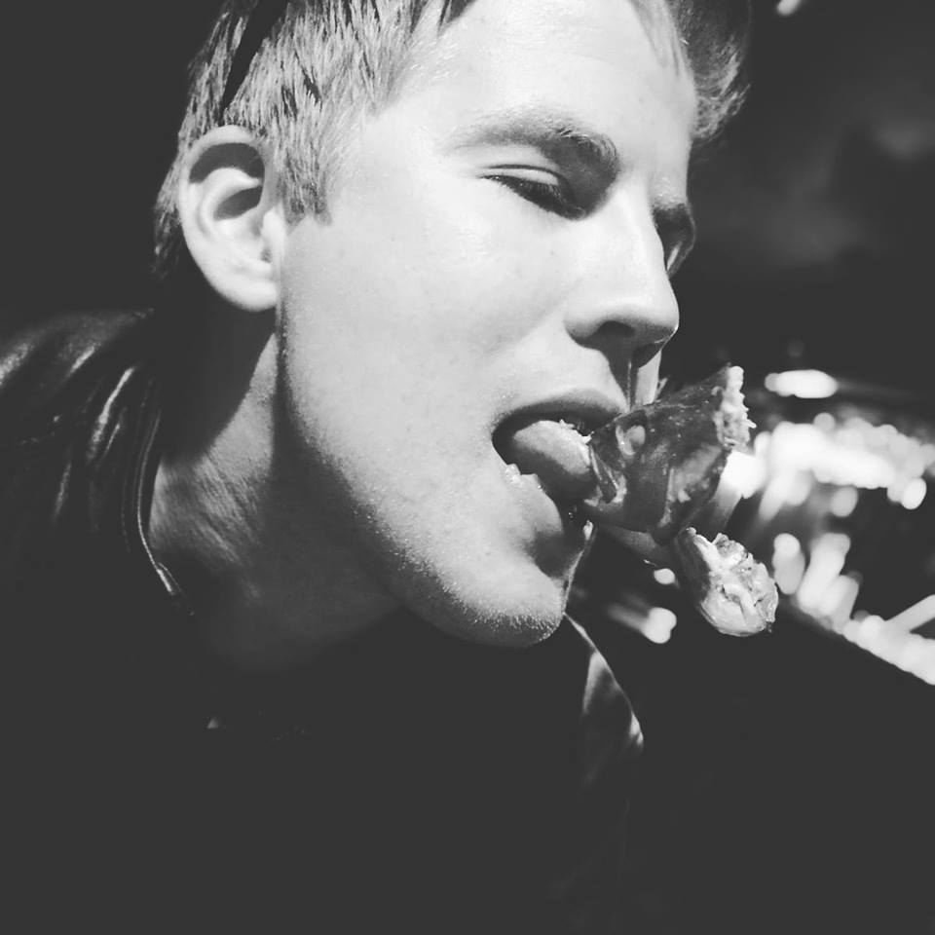
From Team Alpha with Love

Slide 10
What was the minimum requirements that have been set at the beginning of the Sprint last week?
If you have been adjusting that minimum requirements (meaning what you aim for during the first Sprint), briefly explain what it is now? If not please proceed to question 3
Demo the current stage of your application, if you did not have time to put things together for a visual interface that is also fine, you can demo the working function and algorithms that you have done.
What have been the most challenging part(s) of your project?
Keep your Trello board up to date, and use it to explain how far have you managed to progress with your initial plan and what are left to bring it over the finish line. This also gives you a general idea of how much more time you might need to complete this project
There is no 6th question, I just want to add that doesn’t matter how the final product is, if you believe that you have tried to do your best then that should be enough because there is nothing else you could have done. The aim of this project is to give you a chance to learn more from yourself, from each other, as well as to review everything that we have learned. Many of you had never done any programming before this training, 2 months later, you seem to find pleasure if you could easily GET some JSON data to your front end, and avoid having to use back end to build a simple API, and it might be so that those words did not even mean anything to you 2 months ago. The change in your definition of what makes a problem is something you can be proud of J

